Slide 1

CTEC104: Communication and Technology

Slide 2
Researching Information & Critical Thinking, Argument and Persuasion

Slide 3
Learning objectives
Describe traditional and digital resources used for researching primary, secondary and tertiary sources of information.
Discuss sources of library and digital information, and identify criteria used to evaluate them.
Describe the features of an effective literature review.
Explain the role of critical thinking in academic work.
Evaluate the logic in an argument by identifying the relationship between the premise(position or purpose statement ) and the conclusion.
Identify techniques to persuasion and explain how they influence others to change attitudes or take an action

Slide 4
Introduction
Before you can prepare effective essays, assignments, reports, theses and dissertations, you must research well, organise relevant information, identify the document’s purpose and present it in a way that suits the context.
You must research from credible sources and use the format, writing and citation styles recommended by your faculty.
Sound research informs the discussion in the body of an essay or paper, and enhances the power of an argument, and its conclusions and recommendations.

Slide 5
The research process (1 of 2)
Research is the process of finding, evaluating and processing information suited to a purpose.
Sound research requires skills in two areas:
Skills in information seeking, which enable sources of information to be scanned
Critical appraisal skills, which enable analysis and evaluation of the sources to distinguish fact from opinion, question and judge the validity and worth of evidence.

Slide 6
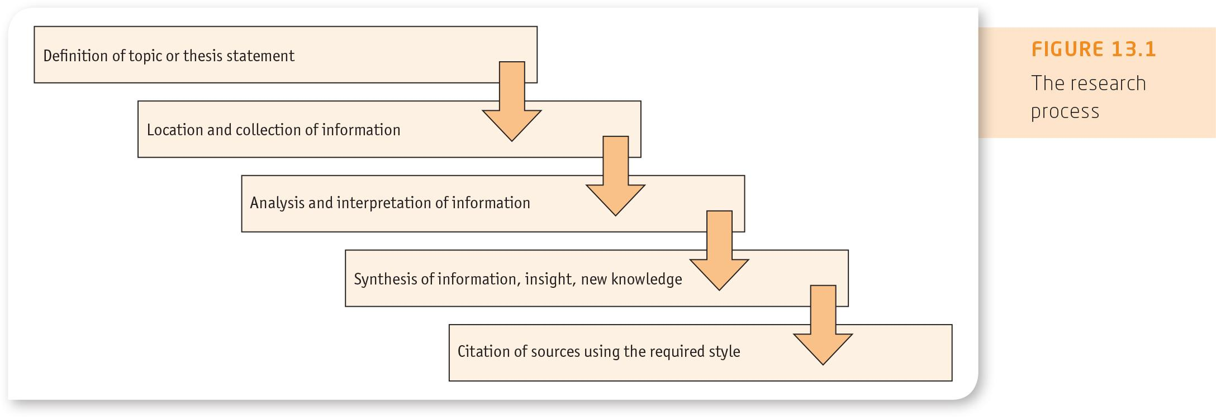
Figure 13.1
The research process

Slide 7
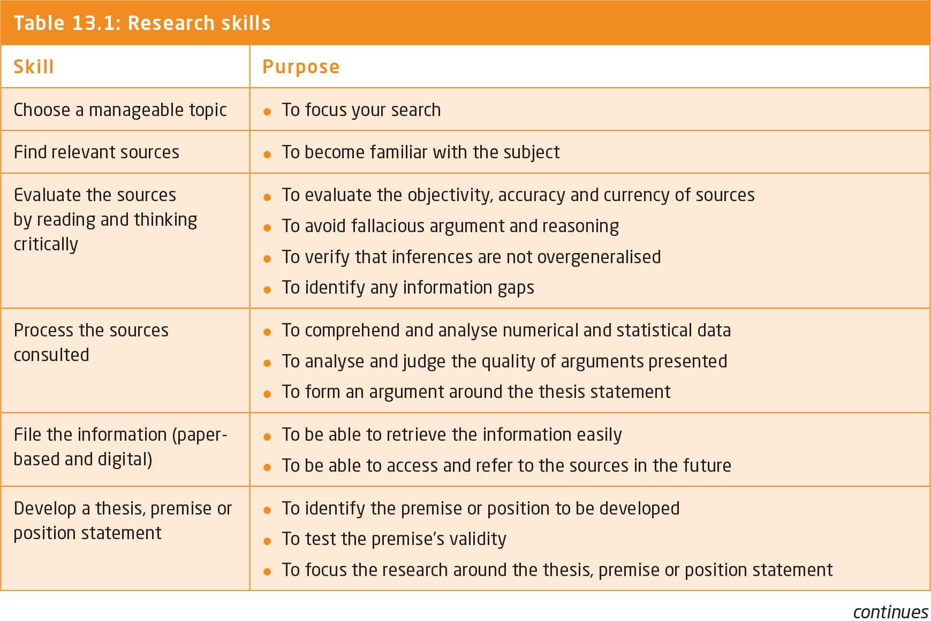
Table 13.1
Research skills

Slide 8
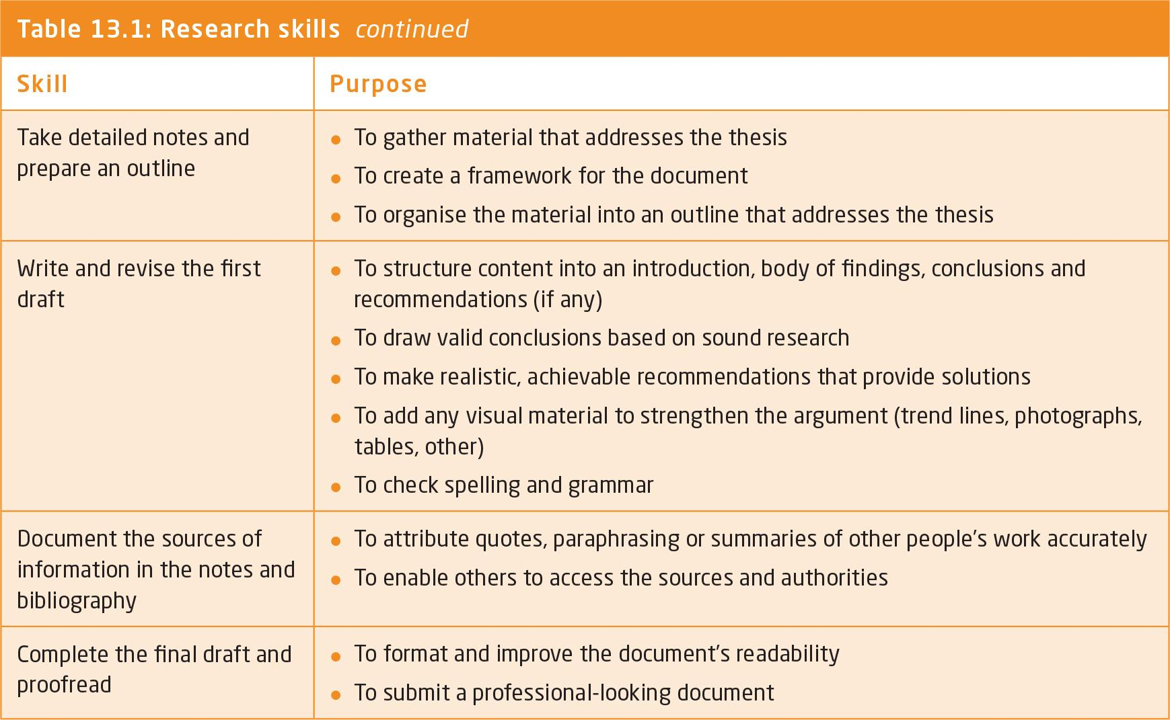

Slide 9
Sources of information
Primary sources :- primary source is a document, speech or other sort of evidence written, created or otherwise produced during the time under study. It offers an original view of a particular topic or event.
Secondary sources:- summaries of information gathered from primary sources. Includes, handbook, dictionaries, encyclopedias, translations, reviews of research, abstracts, books and other publications.
Tertiary sources:- contain information from a variety of secondary sources.
Primary, Secondary and Tertiary Sources - YouTube

Slide 10
Table 13.2
Methods of gathering primary information
Source | Strategy | Purpose
Observation | • Observe the event a number of times. • Check that the observation is of a typical event rather than an atypical or unusual event. • Interpret the observations objectively. • Set up the observation in such a way that background, particular work experience or attitude to others cannot cause the evaluation to be subjective. | Collect information and make an objective evaluation of the data.
Experiment | • Ask questions, define the problem and gather evidence. • Maintain objectivity by analysing the evidence and removing any unsupported assumptions or biases. • Repeat the experiment to check the reliability of the findings. • Offer evidence on the basis of the results of the experiments. | Provide more reliable and accurate information than observation.
Interviews | • Prepare the questions and their order of presentation before the interview. • Conduct the interview by asking questions and recording the answers. • Compile the results after the interview. | Gather facts and opinions that can be analysed and evaluated.

Slide 11
Table 13.2 cont
Methods of gathering primary information
Source | Strategy | Purpose
Questionnaires and surveys (refer to Chapter 14) | • Plan the questions. • Focus on the issue and your purpose. • Administer the survey and collect the information. • Extract and compile the information. • Analyse and interpret the information. | Gather valid facts and information from within small groups, larger organisations or the community at large.
Human resources | • Interview and/or administer surveys or questionnaires with primary sources such as adult community education, workers’ health centre or government department. • Design the questions. • Conduct the interview or administer the survey or questionnaire. • Analyse the information and draw conclusions. | Gather information through direct contact with the source of information.
Files, records and databases | • Focus on a particular company. • Use office files, records and databases to gather current information. • Search background information. • Follow up any expertise on the organisation that is relevant to your information needs. | Collect information on a particular industry or organisation.

Slide 12
Table 13.2 cont
Methods of gathering primary information
Source | Strategy | Purpose
Professional associations | • Contact professional associations, their support services, trade associations or trade unions. • Interview your own business and professional contacts. | Gather professional information relevant to the purpose and information needs.
Social bookmarks | • Register as a user of your preferred social bookmarking site(s). • Use keywords and tags to search for the area of interest. • Consider how many people have used a specific tag and view their comments. • Scan the headings in a folksonomy for relevant information. | View the network of resources on the social bookmarking site and folksonomy created by users.
Really Simple Syndication (RSS) | • Subscribe to an RSS service. • Select and download media files from relevant sources. • Save time and control information overload by navigating directly to relevant resources rather than browsing the vast amount of information on the Web. • Receive automatic updates from favourite websites. | Access a steady stream of current information published in blogs, podcasts, video clips and news items.

Slide 13
Table 13.3 cont
Secondary sources of information
Type | Examples
Library catalogues, which are databases that allow users to search for items owned by a specific library | • Reference books, periodicals, journals, newspapers, magazines, music scores, movies and audiovisual material, fiction and non-fiction books. • Libraries hold their subject, author and title indexes in online computer information systems. • Libraries can access the catalogues of other institutions.
Library databases, which can be general or discipline specific | • ERIC (via ProQuest) is the world’s largest education database. • EBSCO is an index of individual databases. • Scopus is a multidisciplinary database. • Library staff also use online searching services to find Australian and international electronic databases, such as Australian Public Affairs Full Text (APA-FT) produced by the National Library of Australia, full text social science journals or ABI/Inform business journals.
Periodicals and journals relevant to a particular topic, which can be found using the periodicals index in the library | • The Australian Public Affairs Information Service (APAIS), created by the National Library of Australia, is a subject index to current literature in the humanities and social sciences. Search by author, title, subject and keywords in the index to find current literature for your purpose.

Slide 14
Table 13.3 cont.
Secondary sources of information
Type | Examples
Audiovisual and other services | • MP4 files store audio, video, still images, subtitles and text. • Online collections such as Informit TV News contain indexes of Australian television news, current affairs and documentaries from free-to-air TV stations.
Archives, which store historic and public information | • The Commonwealth and state governments have non-current records or documents relating to their activities. • Many large corporations, such as national and global banks, have their old records and documents filed away. • It is possible, although time-consuming, to find information stored in organisations and government departments.
Mass media | • The media produce information in newspapers, magazines, television, radio and film. Information presented in this way is up to date. • Approach the media critically to identify inaccuracies, bias or out-of-date information, and separate facts from opinions.

Slide 15
Table 13.4
Examples of tertiary sources of information (some are also considered secondary)
Indexes and databases | Handbooks or guides | Dictionaries and encyclopaedias
• EBSCO General Science • Film Index International • Humanities Index • Heritage and Environment Index • Austrom • Business Periodicals Index • Scopus • Austlii • Social Sciences Index | • Australian Parliamentary Handbook • Commonwealth and State Year Books • Australian Business Handbook • Who’s Who in Australian Business • Universal Business Directory (UBD) • Style Manual for Authors, Editors and Printers | • The Science Dictionary in Basic English • Concise Oxford Dictionary • Macquarie Dictionary • Webster’s Geographical Dictionary • Australian Commercial Dictionary • Black’s Medical Dictionary • A Dictionary of Acronyms and Abbreviations

Slide 16
The research process (2 of 2)
Digital resources
Includes online databases, journals and articles, newspapers, digital archive collections, e-books and images.
Competent researchers have capability to extract information and contribute information along digital as well as traditional channels.
Digital native has computer literacy combined with information literacies of tagging , searching and retrieving and filtering digital information.

Slide 17
The research process (2 of 2)
Digital resources
Social bookmarking: method of saving and storing web pages in a single online location for future use. It allows any registered user to view web pages corresponding to a specific tag and view the range of tags that given page has received.
Folksonomy: a user-generated index of online materials. People create their own tags rather than classifying to present categories.
Really Simple Syndication (RSS) feeds distribute a blog, podcast, news headlines or website’s new content as it becomes available. RSS example:- Feedly or Gritwire.

Slide 18
Finding sources
Library catalogues
Search engines
Subject web directories and online databases
Bookmarking
Evaluating the credibility and reliability of sources
Evaluating websites

Slide 19
Table 13.5
Types of searches in library catalogues
Type | Purpose
Search a specific index, such as author or title | You want to retrieve only that type of data.
Use a subject index search | You want to browse for items in a particular subject area by searching an index of predefined subject headings.
Use a keyword search | You are not sure what your search term is—for example: • You are unsure whether your search term is a title or a subject heading. • You want to search across many indexes at once.
Search using an ISBN/ ISSN or classmark index | You wish to retrieve a specific item from the library catalogue.

Slide 20
Search Engines
A search engine is a computer program that identifies individual web pages by specific keyword.
Keyword searching is the most common form of searching on the Web.
The best way to conduct a search is to use several search engines, because different parameters, or ways of finding the information, exist on different search engines.
The process of searching on the Web becomes more effective if you can narrow the search terms.

Slide 21
Boolean Operators
Searching online can yield thousands of results.
The three Boolean operators AND, OR, NOT ensure that online searches yield valuable results instead of thousands of unrelated ones (use capitals letters as some search tools require it).
For example, a search for studies on the relationship between ‘empathy’ and ‘self-disclosure’ could use the words ‘empathy’ alone and ‘self-disclosure’ alone. The search would give a list of all works on each word. However, a Boolean logic search using ‘empathy AND self-disclosure’ excludes works that are not about both.

Slide 22
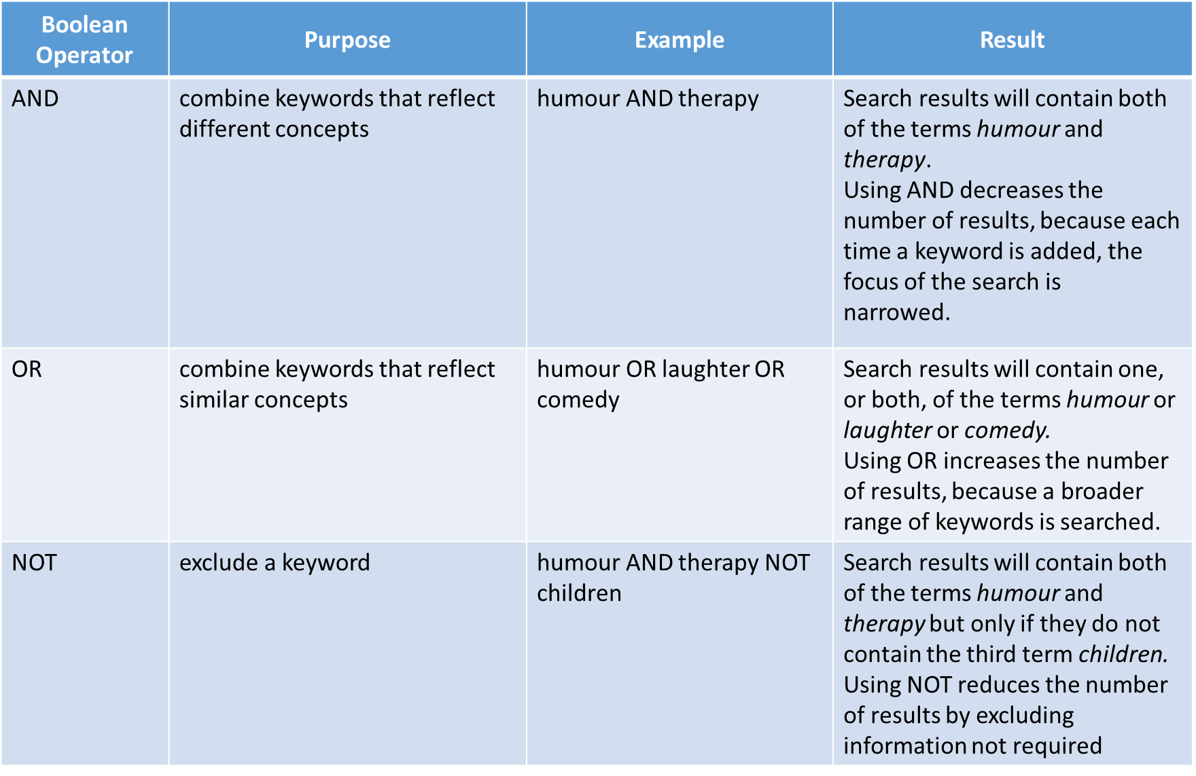
Boolean Operators: Example

Slide 23
Conducting a literature review (1 of 2)
A literature review surveys existing research (scholarly articles, books, dissertations, conference proceedings and other sources) relevant to your area of study.
The purpose of a literature review
Writing the review
review key terms and concepts
provide a summary of major agreements and disagreements in the literature
point out any inconsistencies or gaps in the literature
Organising the body of the literature review

Slide 24
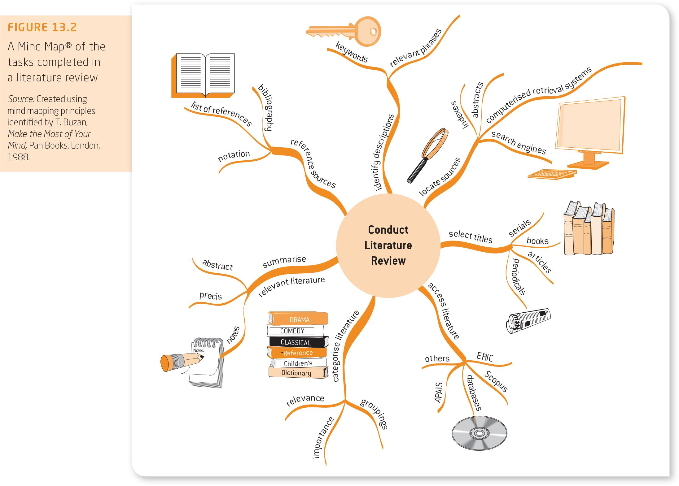
Figure 13.2
A Mind Map® of the tasks completed in a literature review

Slide 25
Introduction
When reading academic documents, you need to question critically and think rationally about your response to the theory or article by developing an understanding of the content and evaluating it.
The universal intellectual standards of critical thinking: clarity, accuracy, precision, relevance, depth, breadth, logic and fairness (Paul & Elder 2010).
Persuasion is the process of convincing another to change their beliefs or behaviour through moral or logical argument.

Slide 26
The role of critical thinking
Critical thinking considers possible viewpoints and results in interpretation, analysis and evaluation of evidence and the conclusions inferred from the evidence.
A critical thinker is skilled at articulating and evaluating arguments, and understanding how evidence supports or opposes a claim.
Critical thinking activities
Critical reading and questioning
Argument: a process of reasoning that shows the relationship between ideas, and aims to convince others of the truth of something.

Slide 27
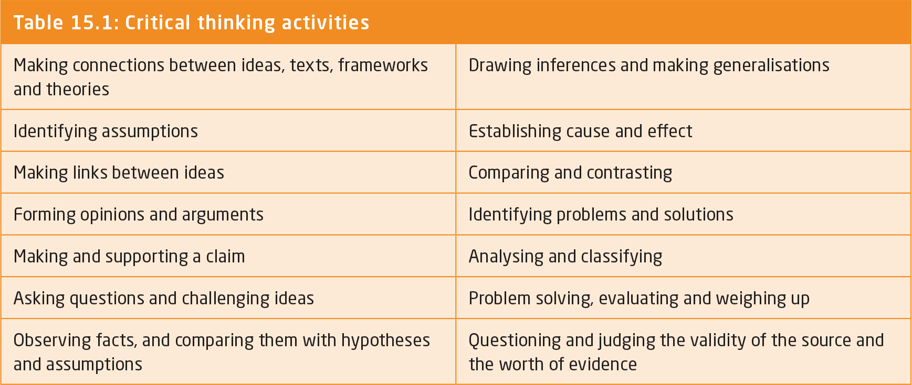
Table 15.1
Critical thinking activities

Slide 28
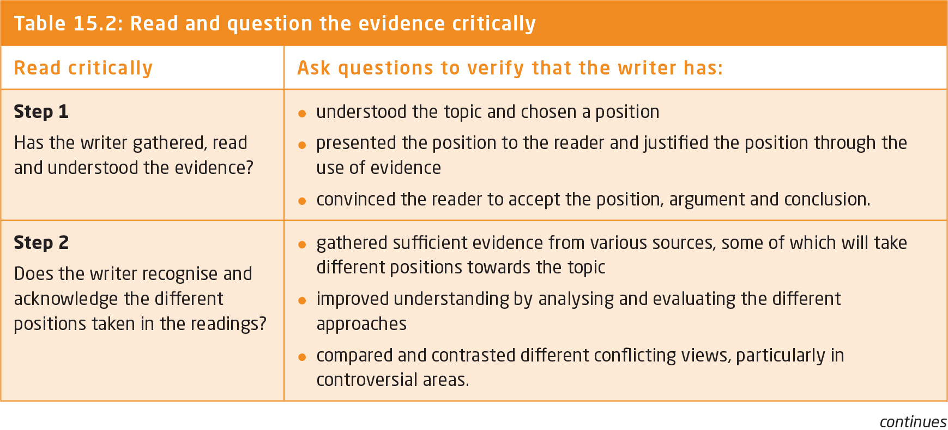
Table 15.2
Read and question the evidence critically

Slide 29
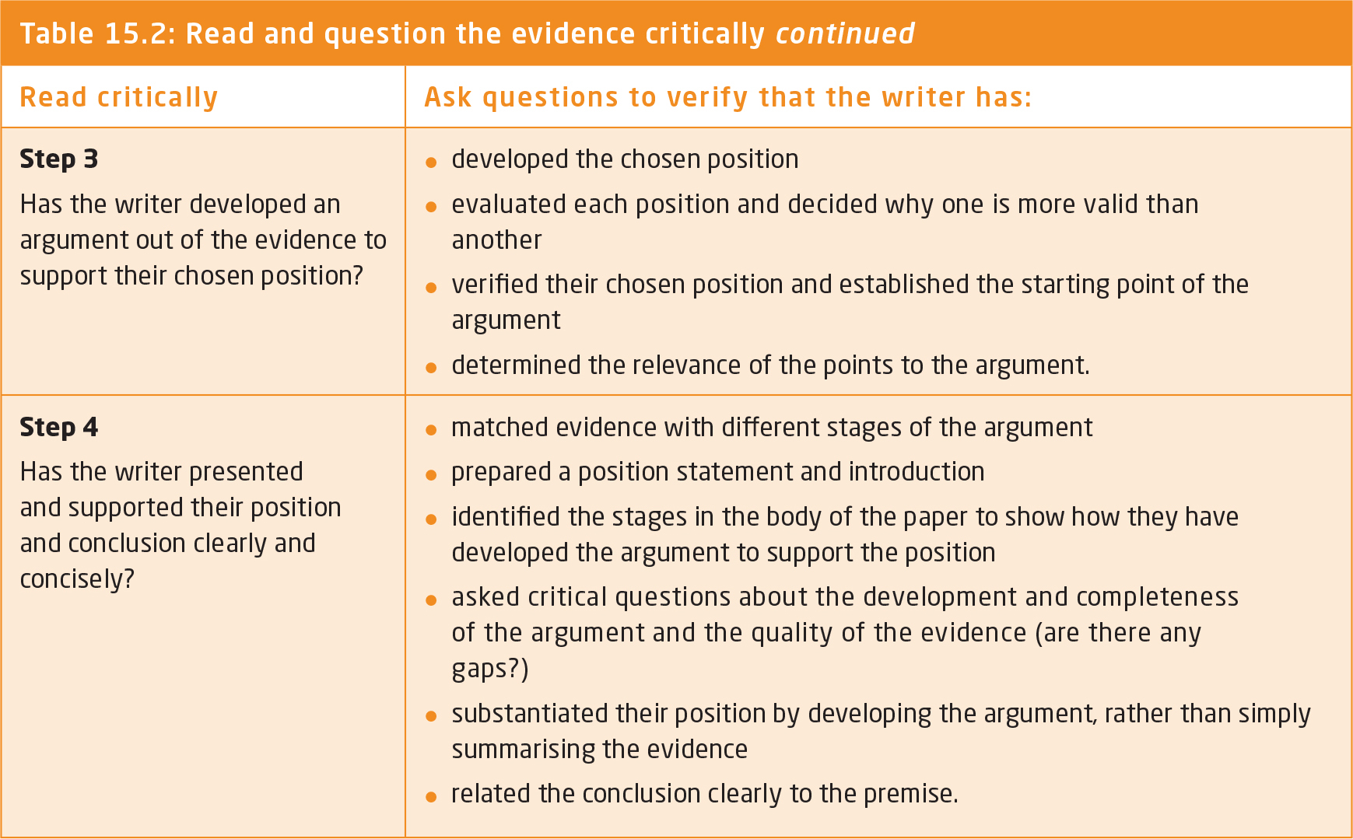

Slide 30
Logic and argument (1 of 3)
Premise: a proposition or claim on which an argument is based or from which a conclusion is drawn.
Conclusion: an idea that requires other ideas to support it.
Deductive and inductive arguments
Deductive: based on logical necessity—if you can accept the premise, you must also accept the conclusion.
Inductive: based on probability—what conclusion is most likely to be expected or believed from the available evidence.
Syllogism: contains at least two premises—a major and a minor premise—leading to a conclusion.
Notes:
What is Inductive Logic? - YouTube

Slide 31
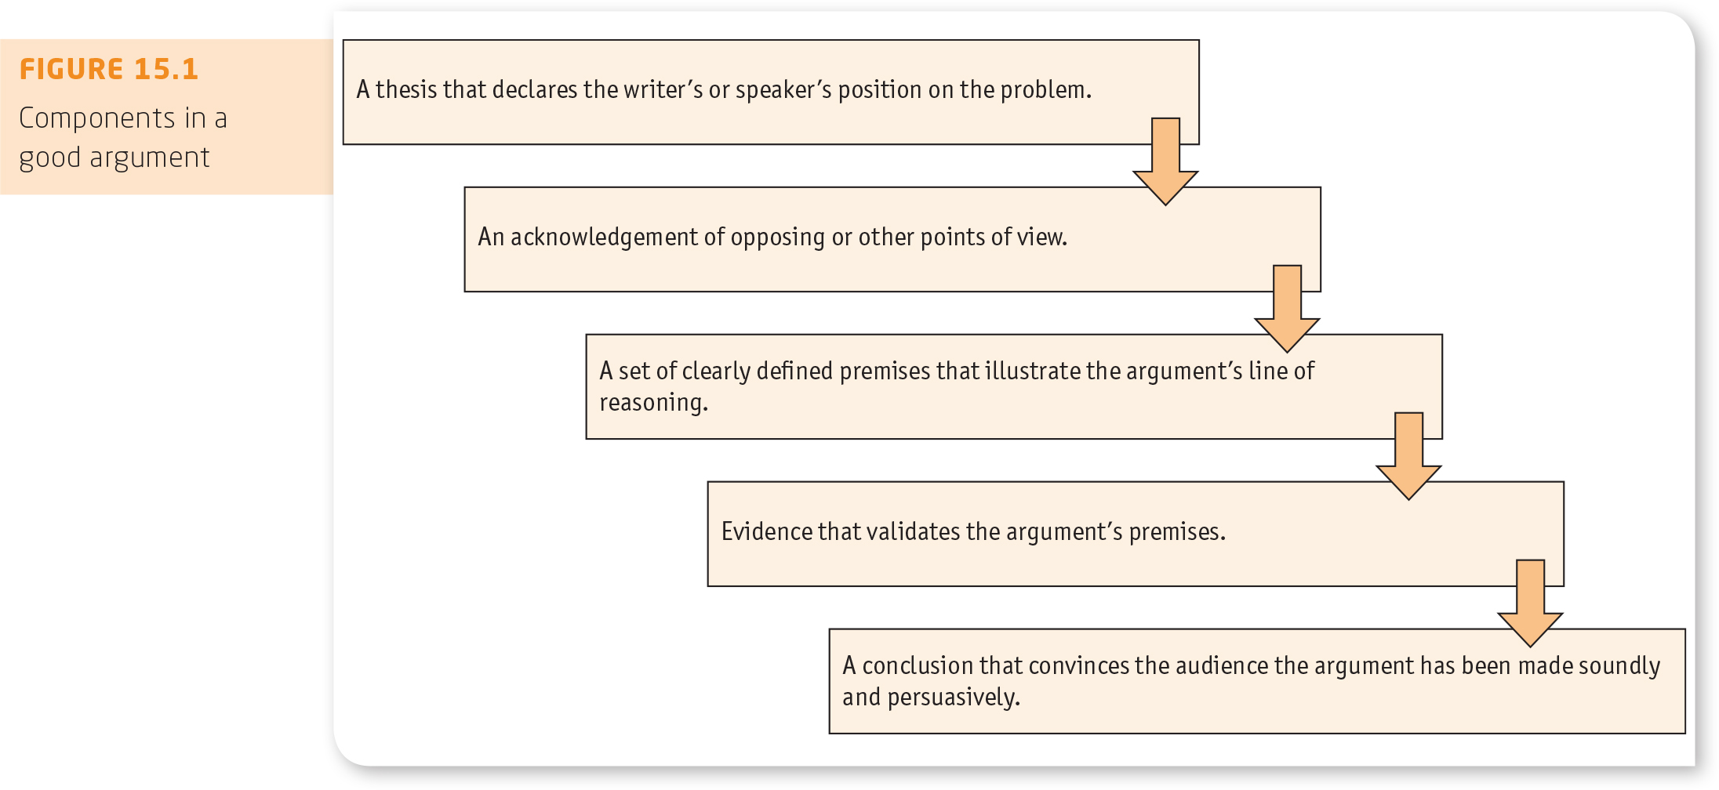
Figure 15.1
Components in a good argument

Slide 32
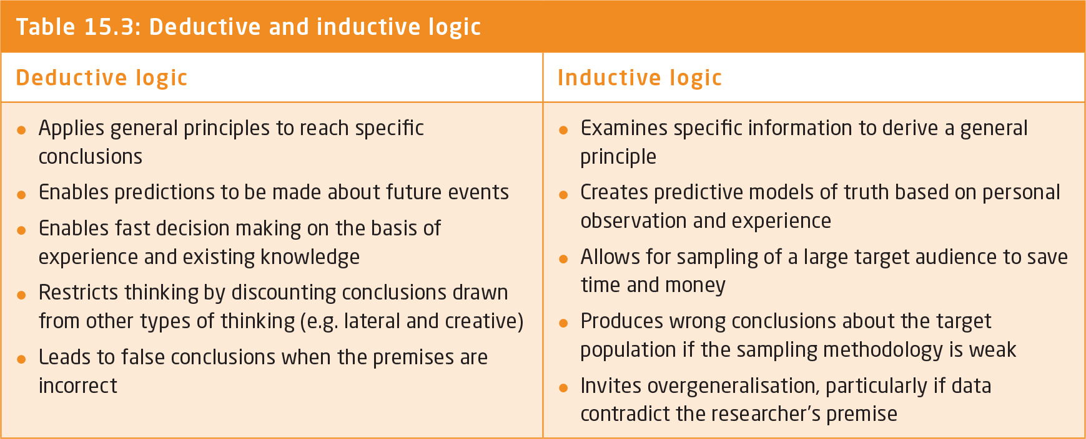
Table 15.3
Deductive and inductive logic

Slide 33
Logic and argument (2 of 3)
Generalisations: give a general, rather than a specific, character to a subject
Fallacy: a type of logical error that leads to a false statement or belief
Sampling: the analysis of a group by determining the characteristics of a significant percentage of its members chosen at random.
Assumptions and evidence
Assumption: an unstated reason that must be true for an argument to work but that is not explicitly stated
Evidence: anything used to determine or demonstrate the truth of an assertion

Slide 34
Logic and argument (3 of 3)
Inference and conclusions
Inference: the process of deriving a conclusion
Opinion a belief held with confidence but not substantiated by positive knowledge or proof
Fallacies—false arguments

Slide 35
The role of persuasion (1 of 2)
Persuasion: the process of motivating or influencing another to change their beliefs or behaviour through moral or logical argument
Persuasive argument
Rhetorical mix
Logos: appeal to logic
Pathos: appeal to emotions
Ethos: appeal to credibility
Features-benefits mix
Appeals to emotion

Slide 36
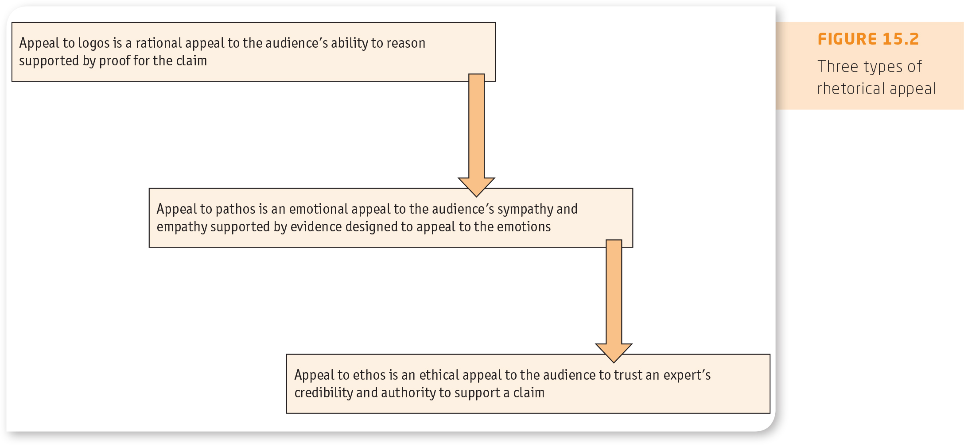
Figure 15.2
Three types of rhetorical appeal

Slide 37
The role of persuasion (2 of 2)
Balance between logic and emotion
An optimum balance between logic and emotion enhances the credibility of the speaker and captures the audience’s attention
Credibility
Education
Profession
Personality
Physical appearance and standard of dress
Respect for others
Knowledge of the problem or issue
Personal and social competence.

Slide 38
Summary
Researchers collect and analyse the existing information and add to the body of knowledge from their own research.
Criteria used to evaluate sources are currency, relevance, authority, accuracy and purpose.
An effective literature review relates directly to the thesis or research question, identifies prevailing theories and hypotheses, identifies areas of controversy, formulates questions, and develops valid arguments supported by up-to-date and credible sources.
Citations/notations acknowledge the work of another author.
A bibliography covers all sources on a topic. A list of references identifies materials cited in the assignment.

Slide 39
Summary Cont.
Critical reading allows you to enquire into existing material and analyse the ideas, arguments and supporting evidence in order to verify or critique the existing body of knowledge.
The basic structure of an argument is: ‘This because of that.’ ‘This’ refers to the conclusion, while ‘that’ refers to the support for the conclusion.
Successful persuasive strategies establish the writer’s or speaker’s credibility, frame the argument to find common ground, provide evidence and connect emotionally with the audience

Slide 40

kent.edu.au Kent Institute Australia Pty. Ltd. ABN 49 003 577 302 ● CRICOS Code: 00161E ● RTO Code: 90458 ● TEQSA Provider Number: PRV12051

